Slide 1

The Twelve Concepts of Service
Al-Anon’s best kept secret?
Notes:
Frequently the only place we hear of the Al-Anon’s Twelve Concepts of Service being applied is in service. Many members do not know that these can also be used in our personal recovery.
This Concept Camp is meant to be used in a meeting or Assembly to go through the Concepts of Service in our personal recovery at home, work, and in groups other than Al-Anon groups.

Slide 2


Let’s see what the Concepts can teach us about service:
In meetings
At home
In our workplace
Let’s have a
Concepts Training Camp
Sports style!
Notes:
This Concept Camp has a sports camp theme. We can go through this in 45 minutes, and it can be expanded on to include ‘live’ member sharings in addition to the sharings of members in the notes. There are two slides for each Concept. The first slide states the Concept and asks us to consider several questions related to applying the Concept in our personal recovery. The second slide has a member sharing and provides an opportunity to invite members to share their experience, strength, and hope on the Concept.

Slide 3
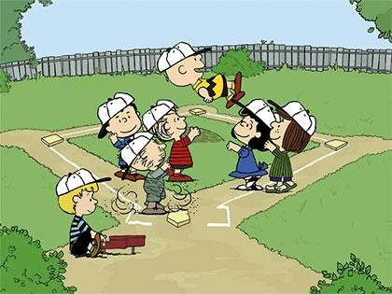
Concept One: The ultimate responsibility and authority for Al-Anon world services belongs to the Al-Anon groups.
Groups exercise their ultimate responsibility by:
Wisely electing people to speak for them
Keeping those representatives informed via the group conscience
Trusting those representatives to do their jobs
Notes:
Concept One is about sorting out responsibilities. Many of us who have lived with alcoholism don’t have a healthy understanding of what we are and are not responsible for.
To apply this Concept in my life I must take responsibility for myself and not try to be the ultimate authority in my family, work, or any other groups. Instead, I:
Trust the group conscience of the group/family/work team
Presume goodwill
Participate in the group as “one of many”
Recognize that others are responsible for themselves and not take responsibility for others
Ask for help with my physical/emotional/spiritual needs when required, and gratefully accept help that is offered
Know which gifts and talents I bring, as well as my limitations
When a controversy does arise, focus on my own experience, strength, and hope and not my perception of others’ thoughts, actions, and motives
Place principles above personalities

Slide 4
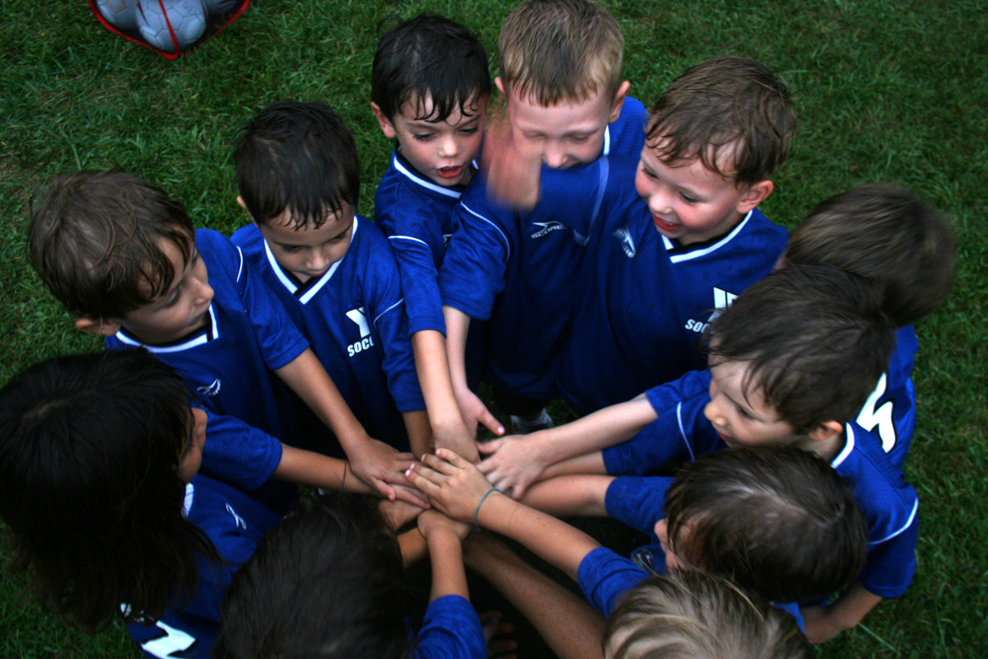
    Concept One
    What is my responsibility in my personal relationships?
    Who is the ultimate authority in my relationships?
    How can I help make my family groups healthy and vital?
Notes:
Member Sharing:
Hi! My name is Idalia. I love doing service in the worldwide fellowship of Al-Anon. Concept One has taught me a lot about responsibility and authority in my group and my life. I grew up in an alcoholic home where I always felt that it was my responsibility to handle everything. I was next to the oldest of five kids, and I always had a deep sense of responsibility of taking care of myself and my younger siblings; because it seemed to me that if I did not take care of things, something awful would happen. There is a quote on Concept One in How Al-Anon Works (B-32) that says “we are responsible for taking care of ourselves physically, emotionally and spiritually. We gradually learn to let go of our perception that we are ultimately responsible for other people, places, and things” (p. 128). I learned about this Concept very early in the program after I attended my first Al-Anon meeting. At this meeting I noticed that the meeting did not start on time, there was some disorganization as to who would do the readings, and what readings were supposed to be read. By the end of the meeting, I understood why I needed to be there, I needed to help these people! I needed to make sure these meetings were organized properly. So, the following week I came back with an outline for how to run the meeting in a smooth and organized manner. During the announcements I presented my plan. After an awkward moment of silence—you know how those are—I was told to “Keep Coming Back.” At the end of the meeting a seasoned member approached me and said to me that meetings consisted of a group of equal members, and that each member of the group has equal responsibility and authority as to how the meetings are to be run. She mentioned to me that I did not need to take on the responsibility of the group, but she suggested that I keep the focus on myself and keep coming back. She also said to me, that eventually if something is important to me, all I needed to do is open it up to the group for discussion. What a concept! I was not alone! Today I know that there must be a unity of purpose. The group as a whole, comes together to determine what they need or don’t need. Concept One has taught me that I am an individual person, separate from other human beings, and as such, I have no responsibility or authority over others. With this Concept I have learned to make clear delineations between what does and doesn’t belong to me. Whenever I get the feeling that I need to take responsibility for people, places, and things, I just use the slogan “Live and Let Live.” Thank you
Al-Anon for the history and depth of this Concept that helps me to live this incredible life I have today.

Slide 5
Concept Two: The Al-Anon Family Groups have delegated complete administrative and operational authority to their Conference and its service arms.
“Service arms” include:
Districts
Areas
Literature Distribution Centers
AIS/Intergroups
Notes:
Concept Two deals with delegation and authority. Delegating can be difficult for those who have learned to do everything themselves, those who struggle with perfectionism, and those who have lost trust in others.
When applying this to my personal recovery, I focus on interdependence:
I consider setting up accountability to help me learn to trust and let go
I focus on completing the tasks delegated to me
I willingly allow others the grace and trust to complete their delegated tasks
I appreciate the talents and strengths others in the group bring and appreciate the interdependence in my group
I ask for help and trust that God will provide the answers I need

Slide 6
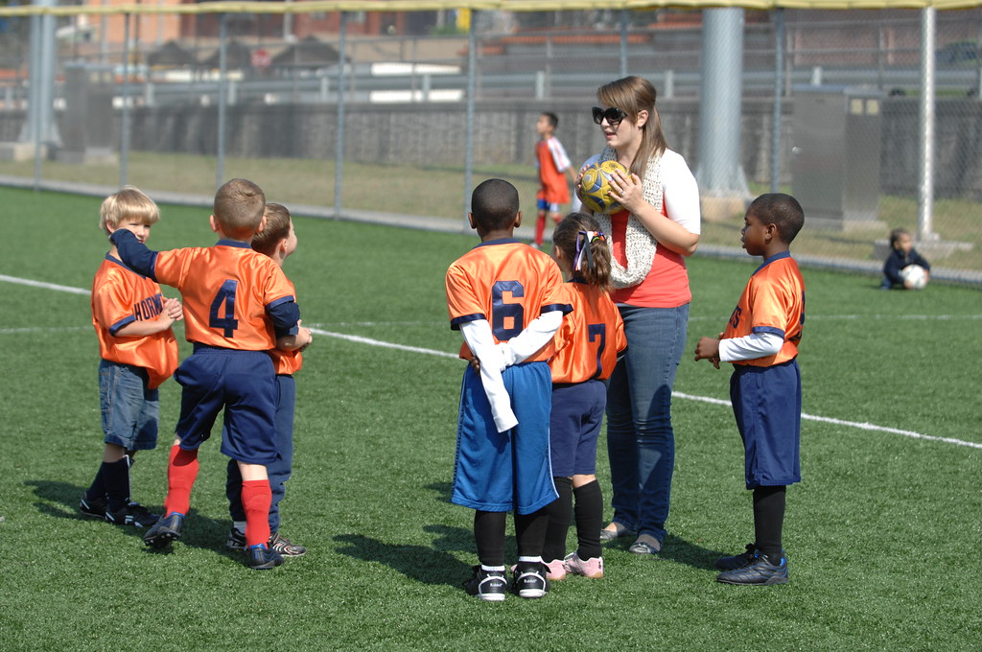
Concept Two
Can I learn how to share responsibility, authority and decision making?
Can I state my view, and Let Go and Let God?
Can I communicate, and listen, courteously?
Notes:
Member Sharing:
Hi! My name is Bill, and I would like to share with you how I apply Concept Two in my personal life and in the workplace today. Two principles of Concept Two are difficult for me, these are: delegation and trust. Far too often in my work and personal life, I have to complete tasks that are someone else’s responsibility. I believe I do this out of fear that the task won’t get done, or won’t get done to my standard of care, and there would be a negative consequence for myself or somebody I care about. Learning to apply Concept Two in my work and personal life is a work in progress for me. Like many Al-Anon principles I have learned to apply in my life, my initial attempts to apply Concept Two in my home and work life were sporadic and tended toward extremes. In my home life, I currently live with my wife and our four adult children. We have a rotating daily chore schedule for routine household chores. These days I am practicing letting others in my household complete their chores on their timeline and to their level of thoroughness without criticizing their work or redoing someone else’s work that was not done to my satisfaction. I continue to struggle with determining an appropriate level of holding others accountable for their responsibilities that neither enforces my tendencies toward perfectionism on others, nor lets them off the hook altogether. In my work life I am practicing delegating tasks to other staff that are appropriate to their level of experience but will still allow them to grow their skills and confidence. Last year I delegated a number of tasks to staff that were beyond their level of abilities to complete and I did not provide adequate guidance and direction. As could be expected, this resulted in poor outcomes. This year I am working on providing an appropriate amount of guidance and direction so that other staff are able to understand what they need to do without taking the task back on myself altogether or providing so much direction that other staff cannot exercise initiative and experience growth.

Slide 7

Concept Three: The right of decision makes effective leadership possible
Principles:
Continuous balance between ultimate and delegated authority
Leaders are trusted servants
Right of decision affords leaders the opportunity to act and lead effectively
This right is a symbol of our implicit confidence
Notes:
How could I communicate with my fellow trusted servants in a way that reflects mutual trust and accountability? Can I listen to others’ ideas and opinions without clamoring to speak? How do I respond when a change to my plan is suggested? Am I open to the possibility that another course of action or decision might work better?
This Concept reflects the benefit of a creative working atmosphere which allows for changed minds and new information, versus a rule-book atmosphere. It’s about placing my trust and confidence in the trusted servants and supporting them in their roles.

Slide 8

    Concept Three
    Do I make good decisions for myself?
    Do I trust others in their decision making?
    Can I learn to cooperate with others and support them, even if I think their decision is questionable?
Notes:
Member Sharing:
Hello, my name is Betty, and I am a member of Al-Anon. I’m going to share about how I use Concept Three in my recovery. Concept Three says, “the right of decision makes effective leadership possible.” How does that look in my personal life? I can use that at a meeting, but what does this look like out there where the rubber meets the road? In my work life, I was a manager of a small agency. My job was to make decisions. I wanted to make decisions that worked for everybody, but it is hard to please everybody. Sometimes I had to make hard decisions, but I didn’t have to make them alone. If it was a decision that was difficult, I was free to ask others for their input, to see what their ideas were and then to make the best decision based on that. “Take what I want and leave the rest” just like in Al-Anon. If I didn’t make the decision myself, I wouldn’t be a leader, would I? How does it look in my home life? My husband is a bit older than me, and he has some health problems. I thought he needed to go to the doctor, and he didn’t want to, but I made an appointment anyway, and of course, I shared that with my Sponsor. She didn’t take that lightly and said it was not a decision that was mine and was demeaning to him. So, it is important to know if the decision is yours or not. Just recently he started to have back problems. Again, I thought he should go to the doctor, but I asked him if he wanted to, and he refused. A little while later, when I could see he was in pain, I offered again. At this time, he accepted and said he would like me to call the doctor and set up an appointment. We took care of it; he got some medication. But it was not enough, and I asked him again, because it was his decision to make, and I didn’t have to make him feel bad about that. Because of this, our household runs a lot smoother. I ask, and I know whose decision it is to make to begin with. Sometimes it’s mine, and sometimes it’s not.

Slide 9

Concept Four: Participation is the key to harmony
  Principles:
Others do their part (mutual trust)
We do our part (mutual respect)
Offer help/assistance
No oversight
Notes:
When I look at myself through the lens of this Concept, I ask myself the following questions:
How does my participation vary, depending on the group with which I am involved (family, Al-Anon, work, friends, etc.)?
Do I ever withhold my opinion or information when I have the opportunity to share it?
Am I granting others the right of decision in their lives or do I give unsolicited advice? (Participation is the key to harmony when I am asked to participate.)
What can I do to participate more fully in my life? Where does fear hold me back?

Slide 10

Par-tic-i-pa-tion is cooperation in five syllables
Concept Four
  Do I realize I belong?
  I am a part of…
  Do I respect myself and others?
  Can I keep an open mind?
  All our voices are important!
Notes:
Member Sharing:
Hi, my name is Bob, and I would like to share for a moment on how Concept Four, “Participation is the key to harmony,” works in my personal recovery.
Prior to, and even sometimes during my early recovery in Al-Anon, there was not much harmony in my home. Decisions were made unilaterally, or sometimes not at all. Anger boiled over, resentments festered, and communication was stifled. I could carry a grudge for weeks. When I found Al-Anon, all that began to change. Members of my home group welcomed me to their community. It was suggested I get a Sponsor, which I did, and we began participating together in service. That meant going to lots of meetings, using the phone list, and most importantly, getting in the car and going to District and Area meetings. It was there that I noticed that the discussions, although sometimes spirited and controversial, were at the same time orderly and respectful. Everyone who wanted to share had their chance, and at the end of the day, we were still friends, regardless of where we stood on an issue. This is where I began to get a real sense of belonging to a worldwide fellowship. There were many voices, and we could all presume good will, even those in the minority. I started to learn to keep an open mind, have respect for, and even encourage other points of view. I could learn to be patient while I listened, and sometimes, as a result, I could even change my mind. Could I learn to do that at home? Could I say what I mean and not say it mean? The good news is, yes, I can make changes in the way I relate to others, and I can make progress as I am willing to let a Higher Power show me how to participate in harmony in Al-Anon and in life.

Slide 11
Principles:
-Open-mindedness
-Listening
-Protect minority opinions
-Respect for different perspectives
-Encouragement
Concept Five: The rights of appeal and petition protect minorities and insure they be heard.
Notes:
Embedded in Concept Five is the right for the group conscience not to change and not to force solutions. Regarding the third bullet, though we have the right to be heard, we don't have the right to be right.
This Concepts reflects spiritual principles of courage and equality. I ask myself:
Do I recognize that access to everyone’s ideas is vital to ensure all decisions are based on the best information available, including minority opinions and grievances?
When I am in the minority or have a grievance in my workplace, family, friendships, or Al-Anon, how willing am I to express that? Am I clear about my intentions?
How hard is it for me to listen with an open mind and heart to people with different opinions? How hard is it for me to listen to someone’s grievance with me or something I’ve done?
How can listening to a minority viewpoint benefit me when I am stuck in my own thinking? How could I invite minority voices in my home/work/other groups to participate?
Have I ever been part of a majority opinion that was not helpful in the long run? What did I learn?

Slide 12
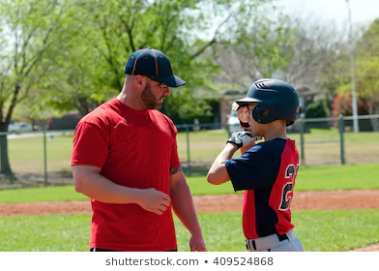

Concept Five
How do I encourage others to voice their opinions?
How willing am I to speak up if I am in the minority?
How willing am I to listen to my family or co-workers?
How can I keep an open mind to different ideas?
Notes:
Member Sharing:
Hi My name is Miriam and Concept Five has always been important to me. I grew up in an alcoholic home and in my home, the sounds of alcoholism were either very loud or completely silent. I voiced my opinion loudly—along with anyone else who wanted to participate in the disagreement—without hearing a word that anyone said. Or, I said nothing—sulking and retreating in silence. Neither option was a viable solution for anyone. Then I found Al-Anon, and I learned how to treat people with respect because I was listened to and respected.
To me, Concept Five is all about balance. I have the responsibility to listen with an open mind to all involved, because everyone has a right to be heard and to be treated with respect, including myself. If a disagreement starts to escalate, whether at home or at work, I can remember to use the slogans “Think,” “Listen and Learn,” and “Keep an Open Mind” then calmly give my opinion and say how I feel without criticizing or blaming. When this trust is established, everyone feels counted and no one is left out unless they choose to be. When Concept Five is used everyone is equal and every voice is heard!

Slide 13
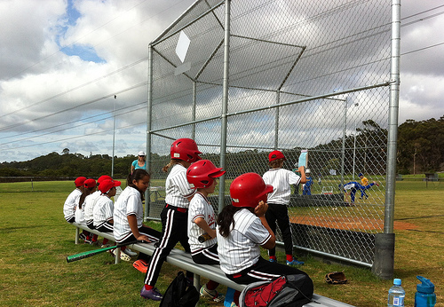

Concept Six: The Conference acknowledges the primary administrative responsibility of the Trustees.
Principles:
shared responsibility
shared leadership
Notes:
In personal recovery, this Concept is about shared responsibility and shared leadership. I ask myself:
What does shared leadership mean to me?
Whom do I trust (“Trustees”) to help me with those parts of my personal life I cannot do effectively? Work life?
How can I be part of a job or obligation and only do my part?
When I need help, do I communicate my needs clearly and courteously?
How can I apply the principle of delegation to my personal life? Work?
Do I doubt others’ abilities?
What is the worst that can happen if someone’s part does not turn out the way I expected it to? Whose responsibility, is it?
What skills do I have that are relevant to the tasks I accept?

Slide 14


Concept Six
How is Concept Six a spiritual principle?
How can I apply this to my work life?
How can I apply this Concept to my family life?
How does this Concept relate to Concept Three and Al-Anon’s “links of service”?
Notes:
Member Sharing:
Hi, my name is Fred, and I didn’t understand how Concepts could be used in my personal recovery, until I studied them with my Sponsor and read about them in The Forum magazine. My Sponsor and I read Concept Six and stated how it applied to Al-Anon and how we could apply it to our own personal recovery. The Conference knows that legal and other administrative tasks have to be taken care of properly and have delegated that responsibility to the Trustees. Well, there are also aspects of entering into a relationship, running a home or raising a family that must be taken care of properly. Some have legal consequences if not done properly, some have consequences that can be costly. And many just have to be done to keep the household running smoothly. It is up to each family to determine and acknowledge who will have the primary responsibility to complete these various tasks. So, Concept Six has and is being used in my personal life—many times without my even knowing it. It has brought a lot of serenity into my recovery and if I keep practicing this principle it will continue to do so. Thank you Al-Anon, for providing me with this knowledge and teaching me to live a serene life.

Slide 15
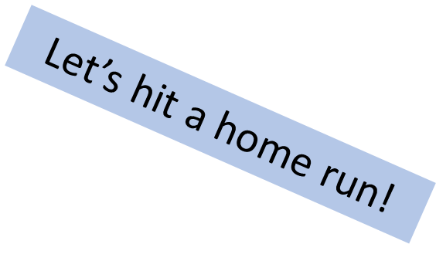


Concept Seven: The Trustees have legal rights while the rights of the Conference are traditional.
Principles:
Responsibility
Balance
Trust
Shared leadership
Authority
Delegation
Notes:
In every group I contribute to harmony by acknowledging my role and its obligations.
I ask myself:
How do I determine the difference between legal and traditional responsibility in my personal life?
How can clearly defining my responsibilities keep me from trying to “fix” the lives of others?
Can I honor my responsibilities in a relationship and maintain a respectful, cooperative attitude towards other members?
Am I willing to cooperate and participate, or do I gossip or criticize?
In my groups, are everyone’s roles and obligations clearly defined and acknowledged?
Do I know what my own role is in my life? How can I bring balance between situations that cross my path in daily life and my spiritual growth?

Slide 16

Concept Seven
How can Concept Seven apply to my home/work life?
What are the things that are out of balance in my life?
What can I do to balance my spiritual aims with my practical living situation?
Notes:
Member Sharing:
Hello, my name is Christine. And I would like to share with you about Concept Seven. There are two types of authority in Concept Seven, practical/legal authority and traditional authority. When we consider practical authority in Al-Anon, we turn to our Board Of Trustees to ensure that the decisions of the Conference are consistent with the law. When we consider traditional authority in Al-Anon, we turn to the spiritual principles of our three Legacies, which are the Twelve Steps, Twelve Traditions and Twelve Concepts of Service. I’d like to share a personal experience with working Concept Seven in my personal life. One hot summer evening my 17-year-old son had planned to get together with some friends he had graduated with from high school. So, he showered and ate dinner. As he was waiting around to connect with his friends, my husband and I were having a conversation with him. It was getting pretty late in the night, and my son shared that he was headed out now to meet his friends and that they would be going to a party. They would have to drive one hour to get to the party, and they had planned to stay for three hours while there. He would have to drive another hour to get back home. As I processed this new information, I told my son that his dad and I were still legally responsible for him and his arrival time back home would be around 2 AM, which was way past his curfew. Therefore, he would not be allowed to go to the party. Concept Seven: legal rights.

Slide 17
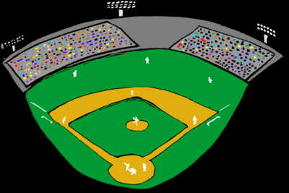
Round the bases!!
Concept Eight: The Board of Trustees delegates full authority for routine management of Al-Anon Headquarters to its executive committees.
Principles:
Delegation of duties
Allowing responsibility by others
Willingness to do the work
Trust
Notes:
Concept Eight embodies humility—I trust others to carry out our routine obligations and remain willing to seek and offer support when needed.
I ask myself:
As my own “Executive Committee,” can I flexibly prioritize my needs, plans, and energies? Or am I resentful when life changes my plans?
How do my attempts to control impact the outcome?
When have I tried to keep the reigns on everything?
Have I reported (to my boss or Sponsor) having too many responsibilities? Was there a solution?
How does it affect my relationships when I ask for, and accept help, and actually trust others to do their tasks?
Is it easier for me to give than to receive? If so, why?
Have I delegated something that is actually my responsibility to someone else? Why?

Slide 18

Concept Eight
How are the management tasks in my home/work life delegated?
What responsibilities or jobs am I willing to delegate to others?
Once I delegate a task, am I willing to trust the results?
In what areas of my life have I had difficulty trusting?
Notes:
Member Sharing:
Hi everybody, my name is Katy. Concept Eight guides me in the areas of consistency, responsibility, and delegation. One of the most rewarding roles I have enjoyed has been acting as an Alateen Group Sponsor. The Group Sponsor role is similar to the Board Of Trustees—by operating as a position of support in the Alateen meeting. The Sponsors ensure a safe atmosphere for all, which allows the Alateens to act as the Executive Committee members by taking on meeting duties such as chairing the meeting, reading the Legacies, and choosing the format. I find that attending on a regular basis and consistently providing a positive attitude, fosters mutual trust and respect among the Alateens and AMIAS. I grew up in Alateen. As a young person living in an alcoholic home, knowing the Sponsor would be there on a consistent basis provided me with surety and comfort which helped balance the chaos at home. Feeling safe created an atmosphere where I could relax and begin to focus on the positive message of Alateen. As a personal Sponsor my role is to encourage the members that I sponsor to move through the Steps and learn how to apply them to their lives. This allows them to become responsible for their own growth and recovery, just like I’m responsible for mine. Like the quarterly board meetings, seeing the people I sponsor at meetings, or touching base regularly over the phone, is key to create an honest and harmonious relationship where both of us can grow. In my home, I act as both a Board member and as an Executive Committee member. Routines are established in order to keep our home running smoothly. This allows each member of my family to perform regular tasks. We may all have to do some jobs we don’t like, but we can tackle them together and create an end result that we all enjoy. Like much of my program, home is the hardest place for me to delegate and let go of the results. I do still find myself re-stacking the dishwasher, or re-cleaning a surface now and then, but because of the program I am able to laugh at myself and make amends if needed, so that everyone’s work is valued and respected.

Slide 19

Concept Nine: Good personal leadership at all service levels is a necessity. In the field of world service the Board of Trustees assumes the primary leadership.
Each player has the potential to grow their leadership skills!
Principles:
Healthy leadership
Rotation of responsibility
Encourage to lead
Vision
Be a good follower
Notes:
This Concept is about integrity and leading by example.
I ask myself:
What role does my Higher Power have in my vision for the future? What roles do my relationships have?
How can putting the focus on myself help me to take on a positive leadership role with others?
How do I demonstrate tolerance, responsibility, flexibility, and vision?
What expectations do I have of a good leader? Am I reasonable in my expectations? Do I have the same expectations for myself?
Do I have a fear of failure or success? Am I afraid of being judged or criticized for my decisions?
What is the leadership structure in my home? Are there power struggles and/or conflict? What might good personal leadership look like?
How am I contributing to and encouraging others’ growth? In what ways am I contributing or standing in the way of my own growth?
Do I allow and/or encourage others to share their feelings and opinions and make decisions without demeaning them when I disagree? Do I feel able to share mine as well?
Do I equate being a leader with being alone?
Do I understand the difference between leading and governing? What is it?

Slide 20

Concept Nine
Each player can find a successful position on the field!
What qualities of leadership have I developed in service?
How has a growing spirituality led me to the right roles in service?
How do I act as a leader in my personal life?
Do I know when to allow others to assume the primary leadership?
Notes:
Member Sharing:
Hi, my name is Patti. The first part of Concept Nine states “Good personal leadership at all service levels is a necessity.” My first experience of leadership in Al-Anon was when I signed up to lead a meeting. Understanding that members in the room would feel more comfortable if I kept the readings in order, that if I chose a topic that welcomed wide participation, it would be a good meeting. I thought about that meeting afterwards and realized that good leadership can create a safe space. It is rarely my first choice to be the leader, but I do recognize good leadership when I have a chance to work with it. I find myself analyzing the particular qualities that make that person a good leader and try to incorporate them into my own growth. Leadership requires that I fulfill my responsibilities to the best of my ability, even if I am responsible only for myself. But if I have accepted a responsibility, others are counting on me to lead, to set an example, to guide—and that is my responsibility. Weak or haphazard leadership leaves others feeling vulnerable and insecure. Bill W. said, “good leadership never passes the buck.” The first time I read that, I was thinking it meant accepting blame or responsibility for a mess. As I’ve grown in this program the idea of blame has just faded away. It’s become more like “this is your show, do the best you can, own your mistakes, take care of others, and use this experience to grow.” The characteristics I have noticed in good leaders always start with listening. In Al-Anon I learned to add the presumption of goodwill, and calm—like I just whispered the serenity prayer to myself—kindness, treating others as I would like to be treated, trust myself—my viewpoint is the only view I can have—which takes me back to listening because I need to understand the viewpoint of others. So, in learning to lead, I am also learning to become more of who I want to be and, in the process, creating a safer space for others around me.

Slide 21

Concept Ten: Service responsibility is balanced by carefully defined service authority and double-headed management is avoided.
Principles:
Staying in my own lane
Goal Clarity
Responsibility/Authority
Trust
Communication
Notes:
This Concept is about balanced responsibility. I must honor boundaries that come from careful definition of responsibility and authority.
I ask myself:
Am I willing to voice my concerns when expectations, job descriptions, and/or family roles are unclear? How would I approach that?
Have I assumed responsibilities that are not mine?
How can I encourage balanced responsibility?
When I recognize others’ attempts at double-headed management, how do I detach from them?
What are examples of my attempts at double-headed management?
How could appropriate boundaries support a harmonious working balance?
If I am responsible for a group effort, how do I inspire the group?
What am I sacrificing when I fail to delegate or clearly define my own or others’ responsibilities?

Slide 22

Concept Ten
To what extent am I involved in double-headed management at home or work?
Am I involved in any situations where one person has responsibility while a different person has the authority?
What kinds of guidelines and definitions would I need to know before I accepted responsibility for a project?
Notes:
Member Sharing:
Hi, it’s Fred. I would like to briefly share with you my experience with Concept Ten. When I first learned of this Concept, I could only picture a big two-headed monster and did not really understand the meaning or intent. Only after serving as our Area Website Coordinator did, I start to grasp the true meaning of Concept Ten. When a new Website Coordinator was elected, after several training sessions, I sat back and watched the new Coordinator go to work. However, if I thought updates were not happening fast enough, or if I thought the items were, in my opinion, inserted in the wrong place, I would change the website myself. When working through the Concepts with my Sponsor, the light came on regarding what I was doing. It was in direct conflict with everything that Concept Ten is about. I promptly contacted the new Coordinator, apologized and stated that I would be hands-off unless I was asked to help. I turned the management of the website over to the new Coordinator and asked my Higher Power to keep me from violating this Concept. This newfound meaning of Concept Ten carried over into my personal life, at work, and home. At work when I delegate a task to an employee, I make sure that they were aware of the results needed as well as any boundaries. Then I stayed out of their way as I let them complete the task. This took a lot of stress out of my life, as well as letting the employees grow and let them see that they were contributing to the success of the company. In my home life, the family members discussed who would do the work that needed to be accomplished to meet our obligations and keep things running smoothly. Once assignments were made, it was stated that no one would interfere with how the tasks were completed. This also eliminated a lot of stress—not only in my life, but also the lives of other family members. It eliminated a lot of yelling and finger-pointing and the jobs got done. So, Concept Ten has brought a lot of serenity into my recovery. I can still fall back into some of my old control habits, but I’m definitely getting better and staying in my own lane. Thank you Al-Anon, for providing me with this important tool.

Slide 23


Concept Eleven: The World Service Office is composed of selected committees, executives and staff members.
Teamwork makes the dream work!
Principles:
Structure with flexibility
Delegation and trust
Respect
Notes:
This Concept is about cooperation, collaboration and unity.
I ask myself these questions:
How could every activity in my life have a spiritual motive?
What is my primary purpose in life and how is it reflected in group efforts?
How do I contribute to an atmosphere of harmony at home/ at work?
How can I respect others when I do not like and/or agree with them?
Do I practice inclusion rather than exclusion?
When have I taken on too many responsibilities? What were my motives?

Slide 24
Using Concept Eleven in my personal life
Concept Eleven
What roles do I play in my home life? At work? In my community?
What principles can I focus on to ease the transition between working alone and with others?
When I delegate a task can I give a general idea of the expected outcome and let go of the process?
How well do I trust others to do their jobs?
Notes:
Member Sharing:
Hi everyone, my name is Kathy, and I am going to talk to you a little bit about Concept Eleven, which is about the World Service Office, its selected committees and Staff members. It’s about how they relate to, and work with, one another. Concept Eleven tells us that we are not alone, that through partnership and collaboration we can get anything done. Through mutual trust, respect for each other, and dedication to a common goal, we can succeed where others have failed. With delegation, shared responsibility, and flexibility we can get things done together and no one is left out and no one is above another. We can all work, and live, in harmony—all we have to do is keep the principles of the program topmost in our minds. From Paths to Recovery, “honesty, fairness, respect, and willingness to keep spiritual principles uppermost in our minds is our best guarantee of continued friendly efficient service in Al-Anon and in our lives” (p. 318). I try and keep that in mind when I am at work, at play, at my Al-Anon meetings, and at home. I’m working on it constantly every day. I use the principles of the program. I’m not saying I am perfect, but I try to be the best human being I can be, and with that comes the efforts of all the people I am around. It just magnifies and multiplies. I am very grateful to be in this position and to be a member of Al-Anon, and for all of you out there. Thank you.

Slide 25



Concept Twelve: The spiritual foundation for Al-Anon’s world services is contained in the General Warranties of the Conference, Article Twelve of the Charter.
Principles:
Prudence in personal relations, money matters, and contacts with the world around us
Equality
Participation
Democratic in thought and action
Notes:
This Concept and Warranties are about presuming goodwill, trusting my Higher Power’s guidance, and practicing prudence and balance in all my affairs. This Concept reflects the wisdom of all thirty-six Legacies.
I ask myself these questions:
When have I acted as the ultimate authority with my spouse, child, at work, those I sponsor, or anyone at all? Do I seek authority, wealth, or power as a goal?
Are there areas in my life where I need to practice more balance—Financially/Emotionally/Physically/Spiritually?
How do I keep an “ample reserve” of what I need—money, energy, serenity, etc.?
Do I think and act democratically in the groups in my life (family, work, etc.)?
If anyone is emotional, how do I allow us time to calm down before continuing?
Have I ever felt personally punitive about someone?
Is “substantial unanimity” a goal in decision-making in my life?

Slide 26
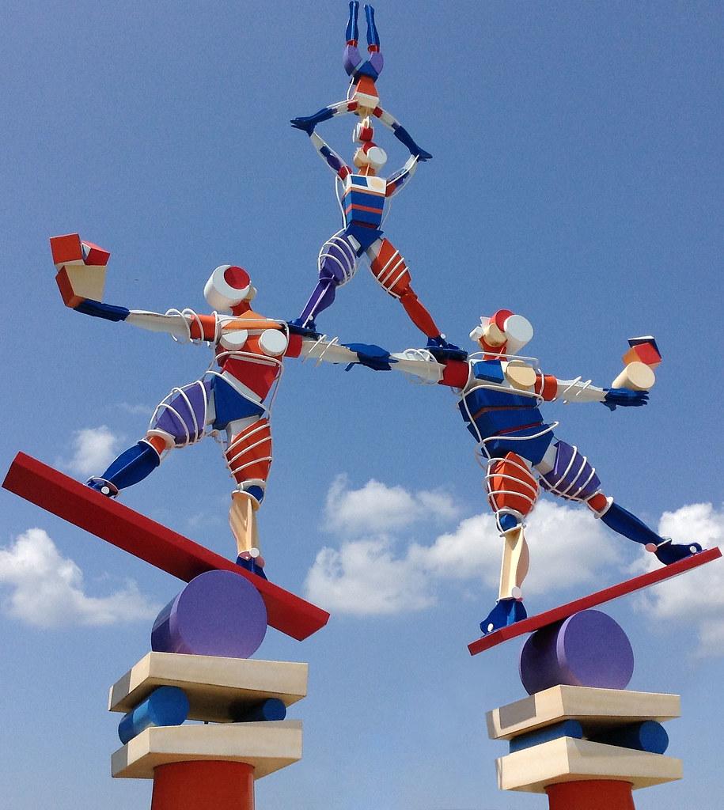
Concept Twelve
Striking a balance—including the Warranties in all our affairs.
How do I incorporate prudence into my financial affairs?
How can I communicate effectively with my family and co-workers to reach decisions that are good for the entire group?
Do I allow my family members/co-workers the right to think for themselves? Do I presume good will as a way of showing mutual respect and love for them?
Notes:
Member Sharing:
Hi, my name is Anu. Before I came into the program, I was the ultimate authority in my home. I worked outside the home, and my husband stayed at home as a stay-at-home dad. Everything about my daily life was about having authority, power, and prestige—at home and at work. What I said ultimately won out. In fact, I was quite punishing if the family members pointed out any weakness in my plan. With my son, I could speak cruelly and shut him down. With my husband, I used a number of different ways including being completely appalled, or disappointed, or using sarcasm, yelling, screaming, banging doors, and when all else failed, giving the silent treatment. I’ve also struggled all my life with balance. When I worked, work was my Higher Power, my family was secondary, my health was secondary. Only in Al-Anon I’ve come to realize the need for balance and how good it feels when I achieve balance—when I’m not practicing the extremes of irresponsible behavior or abject fear. Whether it is in my family relationships or budgeting our expenses. I’ve learned about ample reserve in this Concept. That ample reserve applies not only to my money, but also to energy, serenity. It means not going from one extreme to the other—of being completely consumed in an activity, working out, or something else, or on the other hand ignoring everything about it because I’m scared. Because of Al-Anon, and this Concept, I ask my family for their opinion, I listen respectfully, I discuss openly, consider all of their viewpoints carefully before I make a decision. Because of Al-Anon, I feel that we have democracy in our home and in our family relationship. I’m so grateful!

Slide 27

Together, with the Concepts, we create a winning team!

